Slide 1
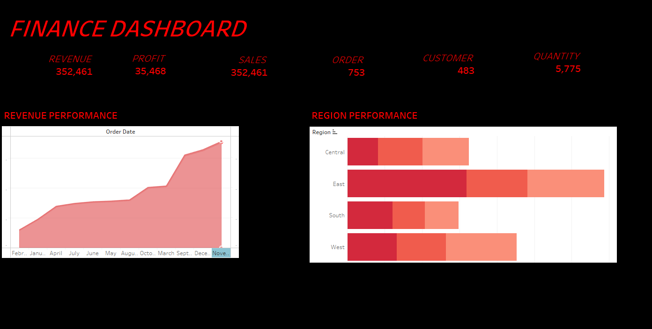

Slide 2
Summary for Financial Dashboard
Revenue: ₹352,461
Profit: ₹35,468
Sales: ₹352,461
Orders: 753
Customers: 483
Quantity Sold: 5,775
Revenue Performance: The revenue trend indicates a good end-of-year performance, with a dramatic increase between October and December and a steady increase throughout the year . According to the plotted data, December seems to be the month with the most revenue
Region Performance: Darker hues denote better performance, with the East area exhibiting the best overall performance across the several measures shown (presumably sales or revenue).The Central and West regions do average. Comparatively speaking, the South area does worse than the others.
Findings: December is the most lucrative month, indicating either year-end demand or strong seasonal promotions . The South region, whose performance is quite poor, could be one of the focus areas for improvement. The East is in the lead and may be further utilized for growth or advancement.

